Slide 1
Unit 203: Electrical installations technology
Protective devices

Slide 2
Protective devices
Faults will generally cause one or both of the following to occur:
overcurrent
earth leakage.
Overcurrent:
A current exceeding the rated value. For conductors the rated value is the current‑carrying capacity.
Overcurrent can be further subdivided into two categories:
overload current
fault current.

Slide 3
Protective devices
Earth leakage (protective conductor current):
Electric current appearing in a protective conductor, such as leakage current or electric current resulting from an insulation fault.

Slide 4
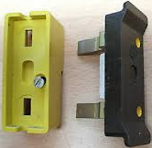
Protective devices
BS3036 semi‑enclosed fuse
Available sizes are:
5A (white)
15A (blue)
20A (yellow)
30A (red)
45A (green).

Slide 5
Protective devices
Advantages:
simple to check if blown
low cost to replace fuse element
no moving parts.
Disadvantages:
danger of being repaired with wrong size wire
deteriorate with age
circuit cannot be quickly restored
cannot break large fault currents
danger if replaced on faulty circuit (melting wire)
fusing factor of around 1.8–2.0 means that they cannot be guaranteed to operate up to twice the rated current that is flowing. As a result, cables protected by them must have a larger current‑carrying capacity.

Slide 6
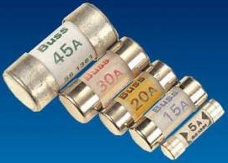
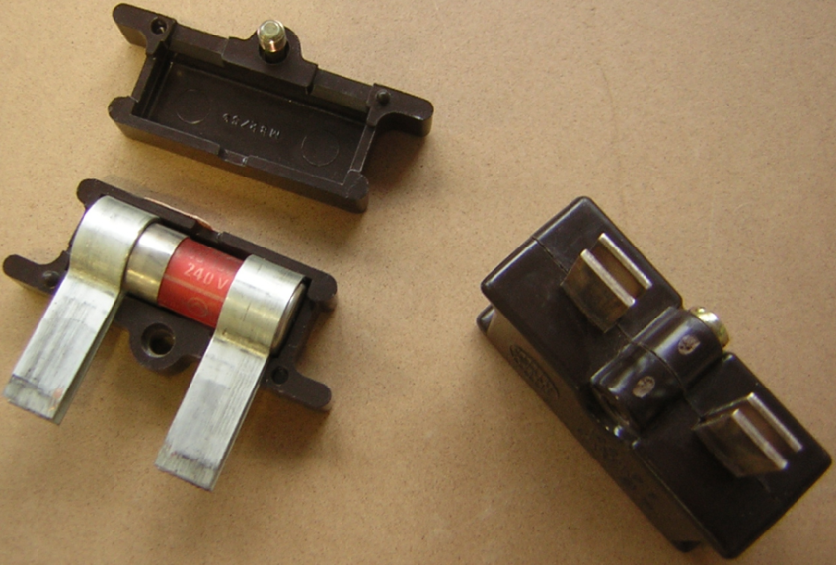
Protective devices
BS88‑3:2010 cartridge fuses (replacing BS1361)
Advantages:
small physical size
no mechanical moving parts
accurate current rating
not liable to deterioration with age
fusing factor 1.6–1.9.
Disadvantages:
more expensive than rewireable
can be shorted by silver foil
cannot break large fault currents.

Slide 7
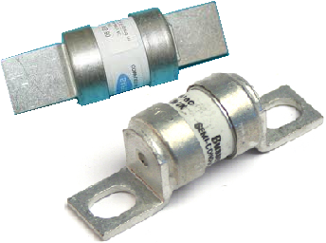
Protective devices
BS88‑2:2010 fuses (replacing BS88‑2 and BS88‑2.1)
Advantages:
no mechanical moving parts
declared rating is very accurate
operation is very quick
with gM fuses you can distinguish between a persistent fault and a transient fault such as the large starting current taken by motors
reliable – it can break large current safely
fusing factor 1.25 – 1.70.
Disadvantage:
expensive.

Slide 8
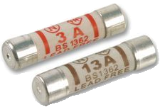
Protective devices
BS1362 cartridge fuses
Especially for use in the standard UK BS1363 13 ampere plug top.
This cartridge fuse breaks a faulty circuit in the same way as other fuses.
When the BS1363 plug was first introduced, there were five fuses in the official BS1362 range (with their specified colour): 2 (blue), 5 (grey), 7 (black), 10 (yellow) and 13 (brown) amps.
The current version, BS1362:1973, allows any fuse rating up to 13A, with 3 amp (coloured red) and 13 amp (coloured brown) as the preferred (but not mandated) values when used in a plug.
The purpose of the plug mounted fuse is to protect the flexible cord, not the appliance itself.

Slide 9
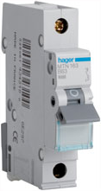
Protective devices
Circuit breaker to BS EN 60898
Advantages:
tripping characteristics, and therefore circuit protection, are set by the installer
circuit protection difficult to interfere with
the circuit provides discrimination
a faulty circuit may be easily and quickly restored by an unskilled operator.
Disadvantage:
they contain mechanical moving parts.

Slide 10
Protective devices
Circuit breaker to BS EN 60898
Circuit breakers’ two means of tripping:
thermal trip that operates relatively slowly and is ideal for detecting overload currents
magnetic tripping device that operates very quickly and is ideal for detecting fault currents.

Slide 11
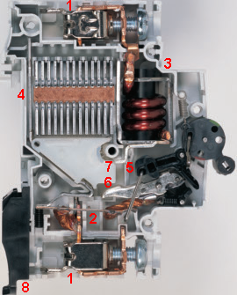
Protective devices
Circuit breaker to BS EN 60898
Box terminal
Thermal element
Magnetic hammer action solenoid
Arc chamber
Trip bar
Moving contact
Fixed contact
DIN clip

Slide 12
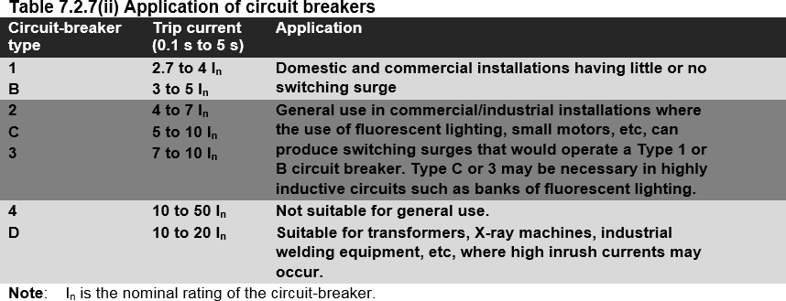
Protective devices
Circuit breaker to BS EN 60898

Slide 13
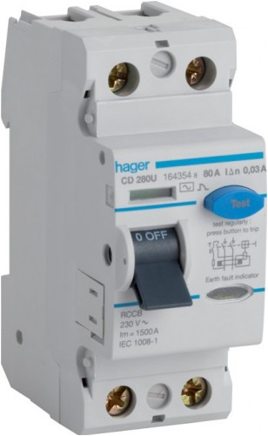
Protective devices
Residual current device (RCD) BS EN 61008
In order to detect much smaller leakage currents that could still be lethal to life, an RCD must be used.
An RCD compares the current flowing out through the line conductor with the current returning through the neutral; if the current exceeds a predetermined value, the device will trip and disconnect the circuit.
The rated value is referred to as the I_{Δn} and is usually rated in mA.

Slide 14
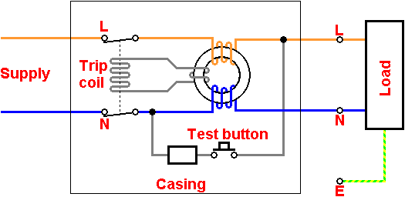
Protective devices
Residual current device (RCD) BS EN 61008

Slide 15
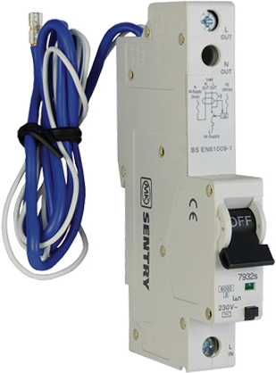
Protective devices
Residual current operated circuit breaker with integral overcurrent protection (RCBO) BS EN 61009
An RCBO is a combination of a thermal‑magnetic circuit breaker and an RCD.
It allows earth fault protection to be restricted to a single circuit.
With most devices, two additional wires must be connected in order for this device to function.
RCBOs are available in types B and C but not in type D.

Slide 16
Unit 203: Electrical installations technology
The End

